Slide 1
Strategic Communications Plan Recommendations
Phil giaramita
Public affairs & strategic communications officer

Slide 2

Implementation Schedule
Of the 15 recommendations presented on
April 25, 2013:
11 are now in the planning stage:
  6 are being accomplished using existing resources.
  2 require supplemental funding from other departments.
  3 are awaiting School Board approval.
4 will be built into the 2014-15 funding request.

Slide 3

Add text messaging to our current
notification system
Upgrade design and
publishing software
Reformat the Compass
to expand user access
and content
Add a Communications policy component to new employee orientation
Add grant writing research and development capabilities to Central Staff
Subscribe to ProfNet media services

Slide 4
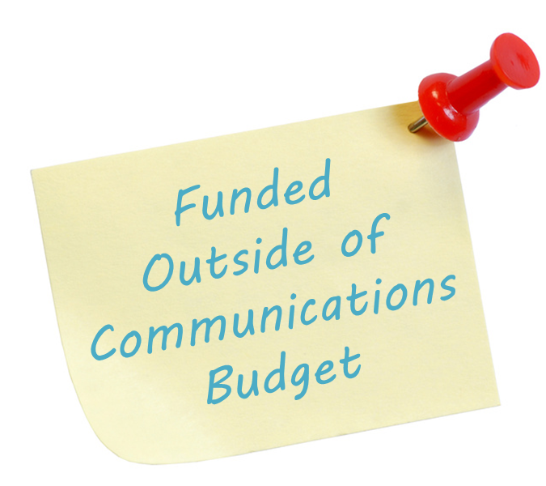
Support Horizons 2020 communications campaign
(estimated cost: $5,000)
Host regional Educational Leadership Conference
(estimated cost: $2,500)

Slide 5

Redesign school board home page to include individual reports in multiple platforms
(print, video), at least
two per school year for
each board member.
Live-stream (audio)
school board meetings.
Live-stream (video and audio)
individual town halls hosted by school board members, at least one per school year for each school board member.

Slide 6

Realign communications stipend
(estimated cost: $22,000)
Expand multilingual
capabilities
(estimated cost: $8,000)
Develop mobile app
(estimated cost: Not to exceed $30,000)
Add new video instruction, professional development, communication and production capabilities across the division
(estimated cost: $70,000)

